Slide 1
Model Training
Farhan Rahman

Slide 2
Image set used
The images were collected for 25 patients summing up to a total of 11000 images.
Each images was classified as anesthesia low, okay and deep.
Further split into training , validation and test set in ratio of 70:20:10.
The images of the training set looks like the following slide

Slide 3
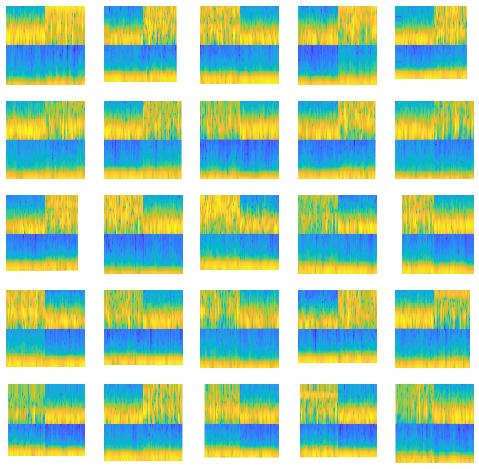
Training set Image

Slide 4
Model Used :
Model | Training Accuracy | Validation Accuracy | Test Accuracy
AlexNet | 88% | 78% | 76.7%
VGG19 | 89% | 79% | 78%
Self trained model | 88% | 82% | 81%

Slide 5
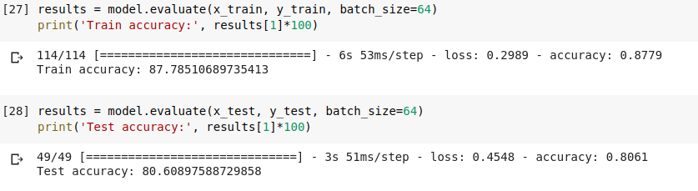
Accuracy Results:

Slide 6
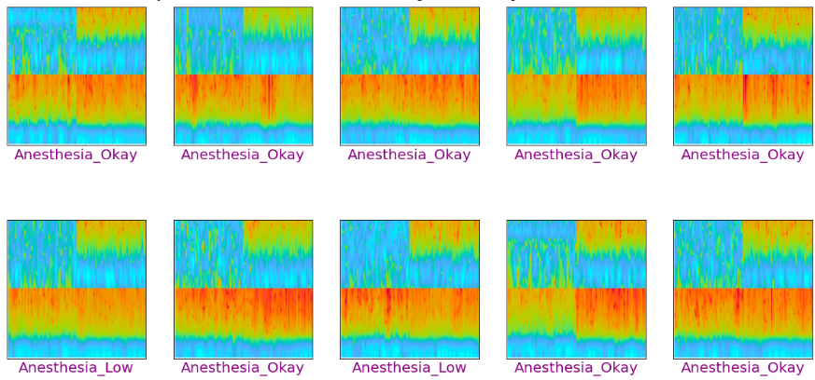
Training:

Slide 7
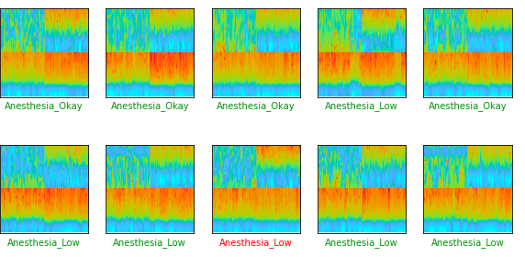
Prediction:
The green label shows correct prediction while the red label shows incorrect predictions

Slide 8
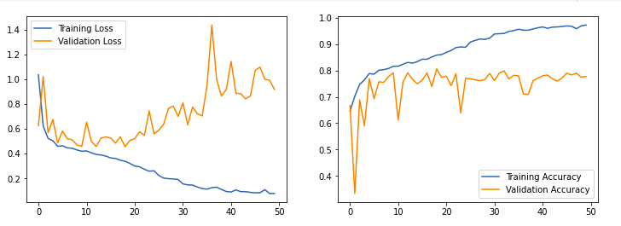
Plots:

